Slide 1

Introduction
Peter Galante
Biodiversity Informatics Scientist
Center for Biodiversity and Conservation
American Museum of Natural History

Slide 2
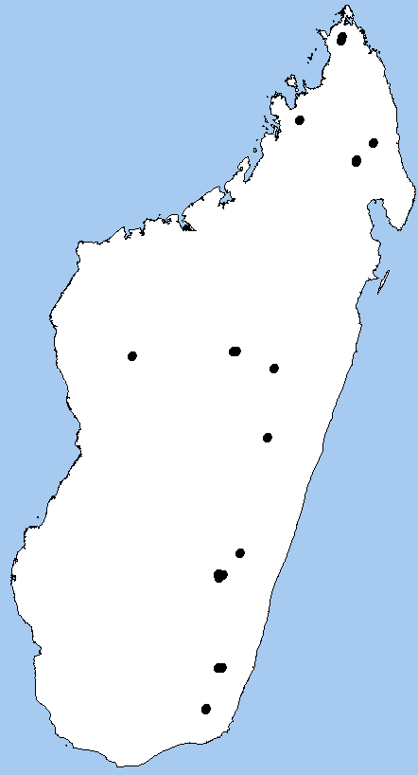
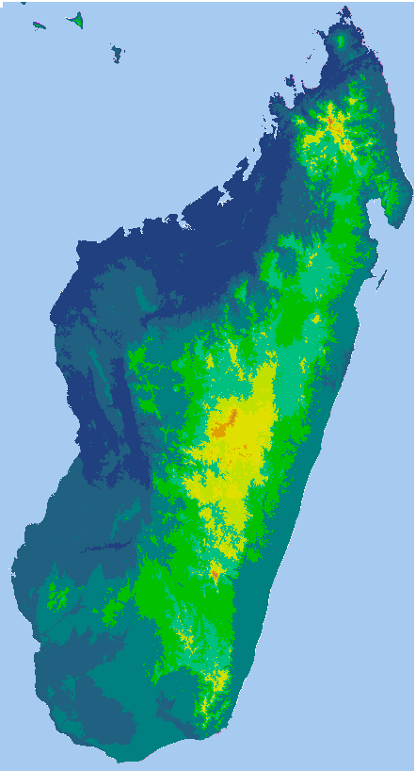
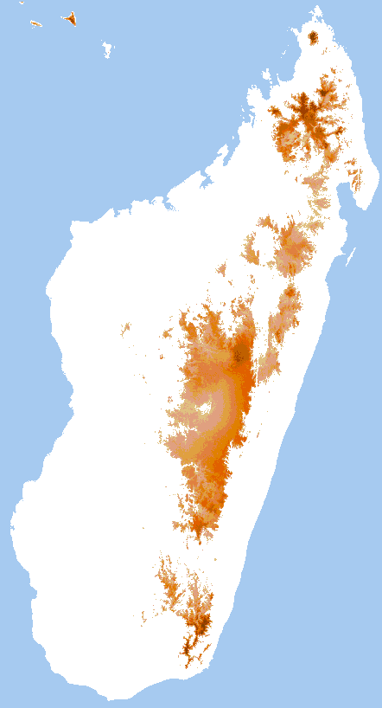
Niche Models
+
Maxent
Abiotically suitable areas
Occurrence localities
19 bioclimatic variables
(Hijmans, 2005)

Slide 3
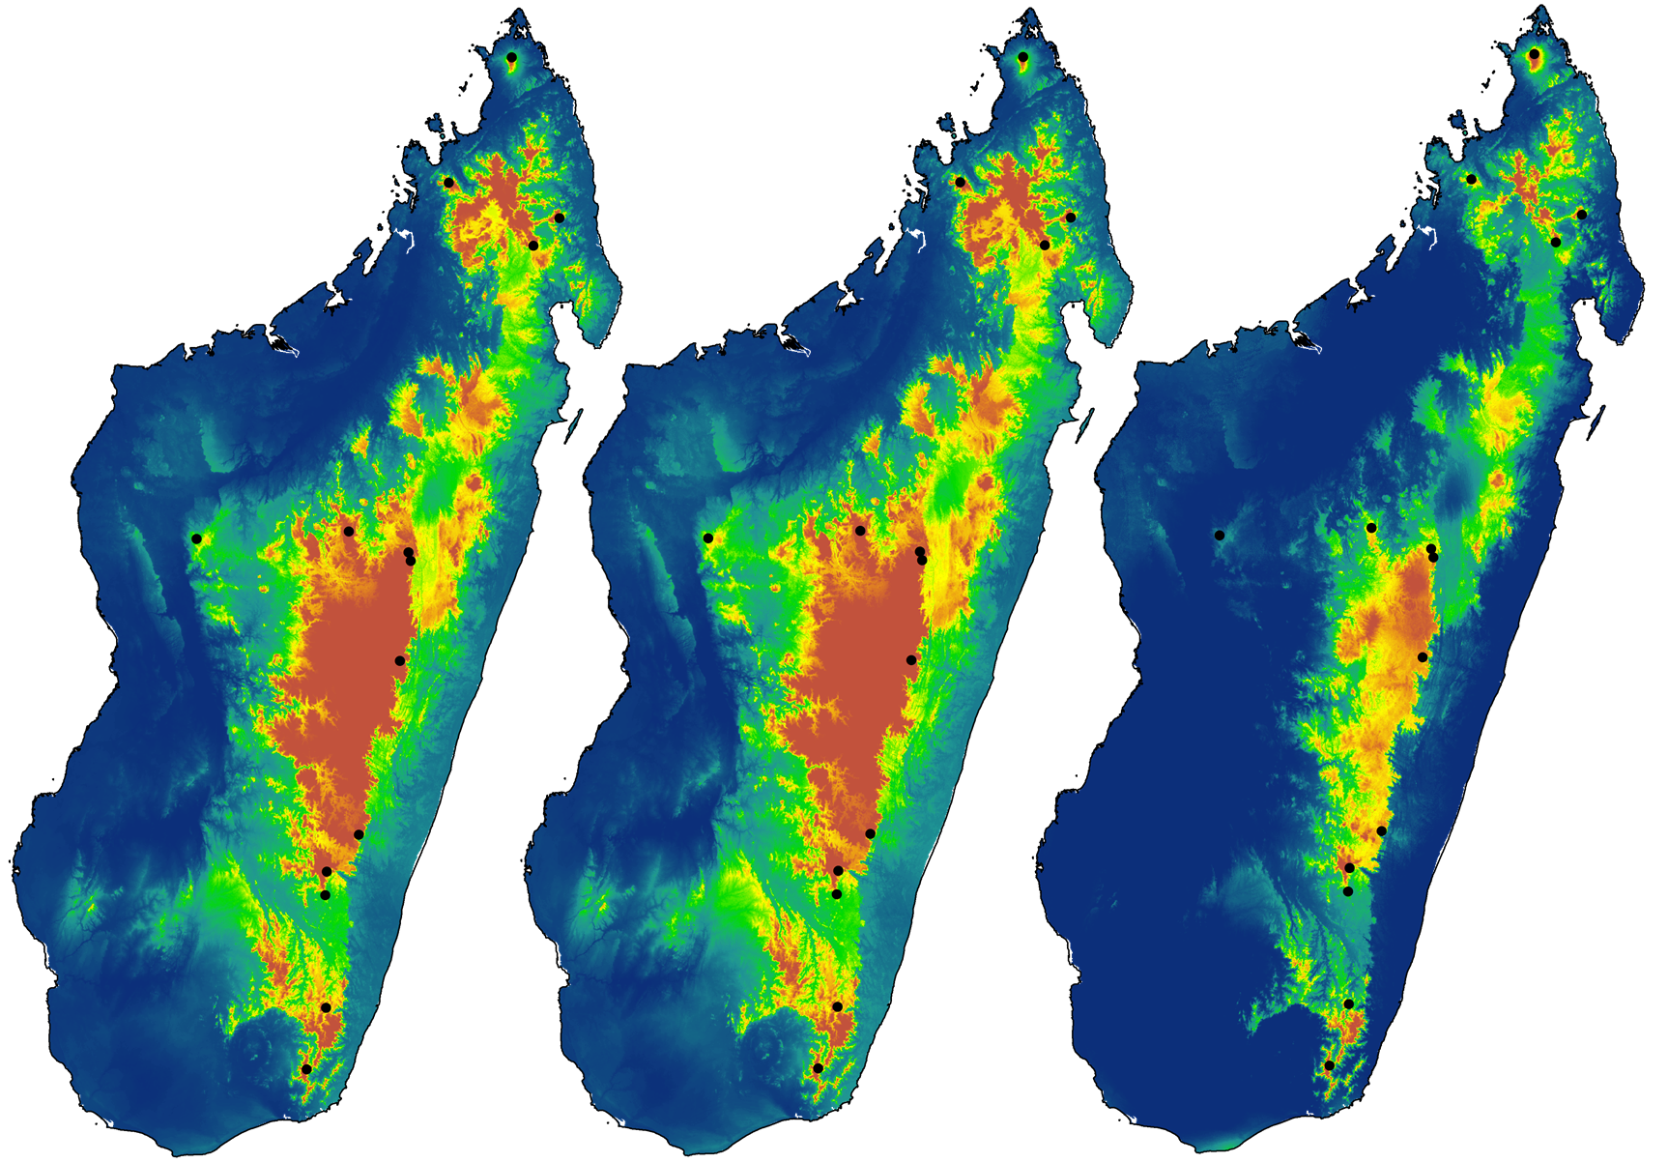
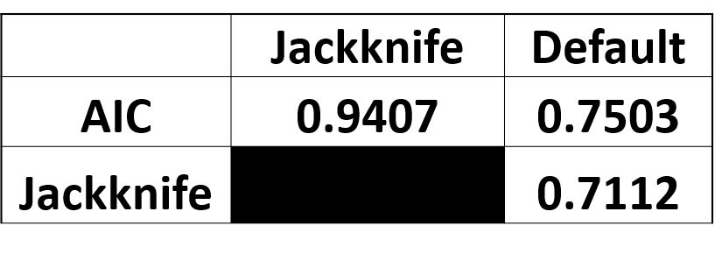
Niche Models
AIC optimal: H3.5
Jackknife optimal: H4.25
Default: LQ1

Slide 4
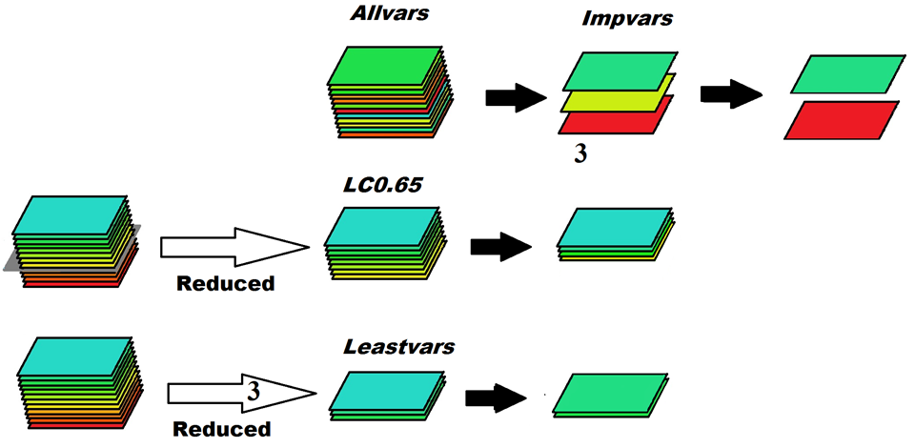
Variable Importance

Slide 5
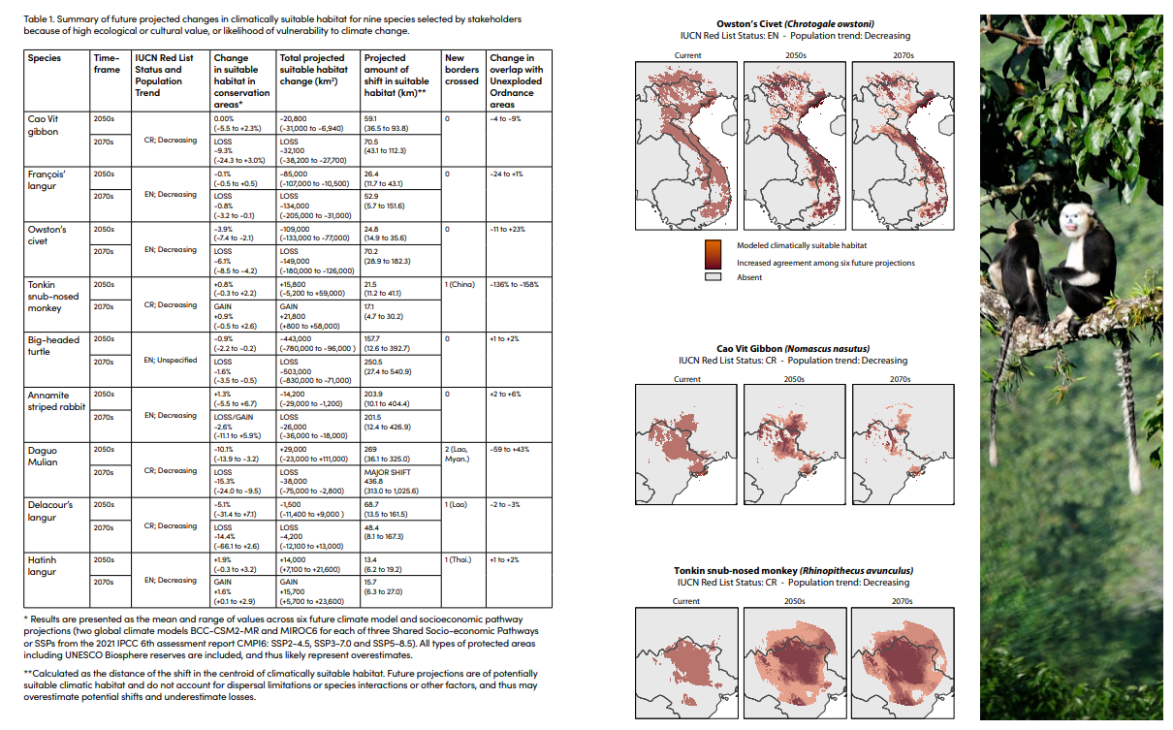
Conservation

Slide 6
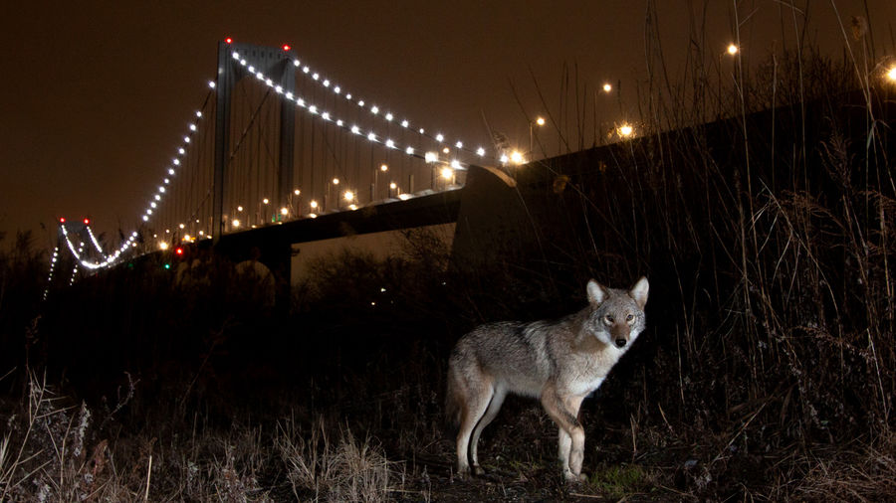
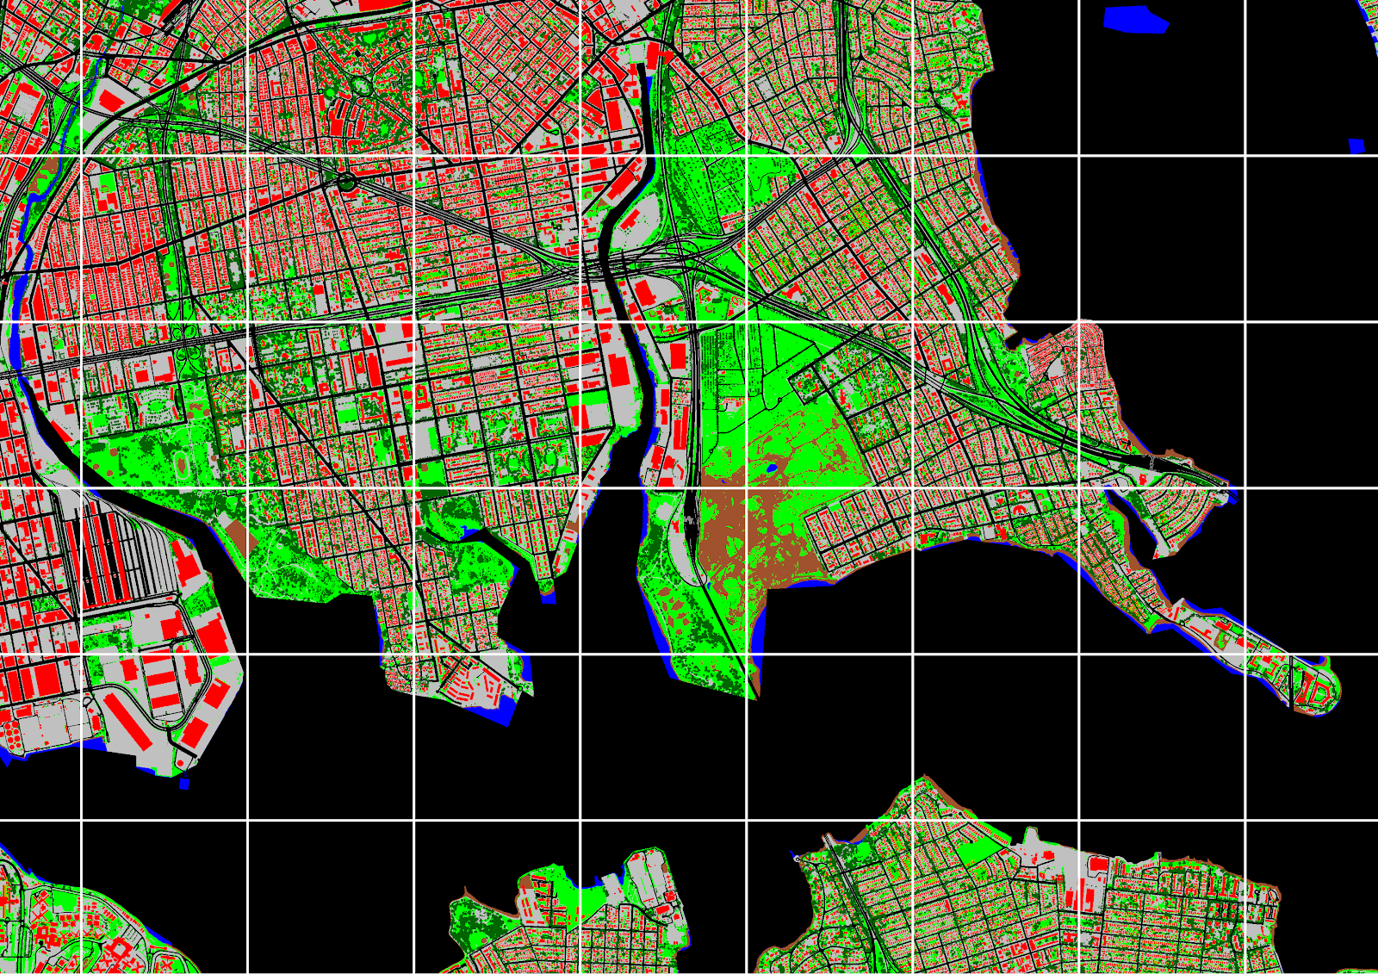
Coyotes

Slide 7
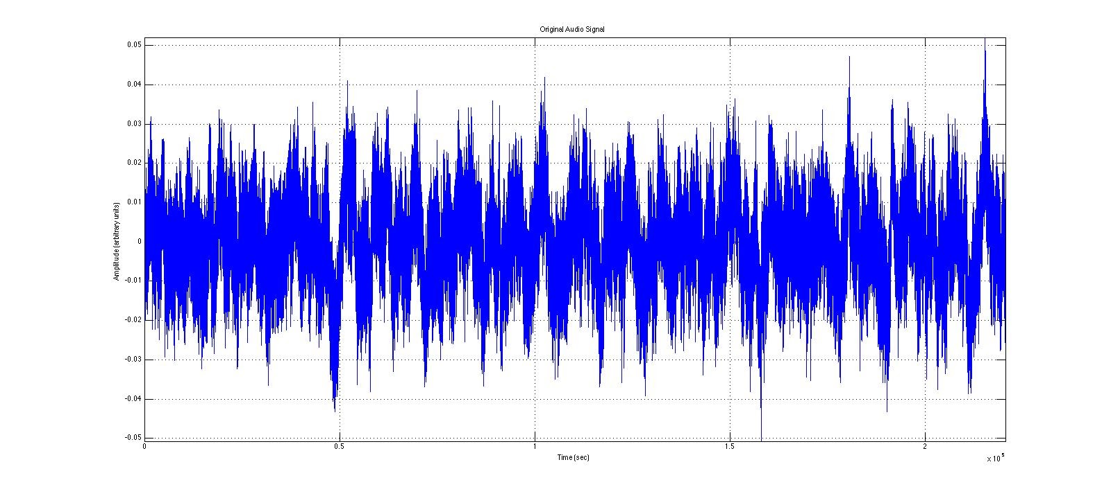
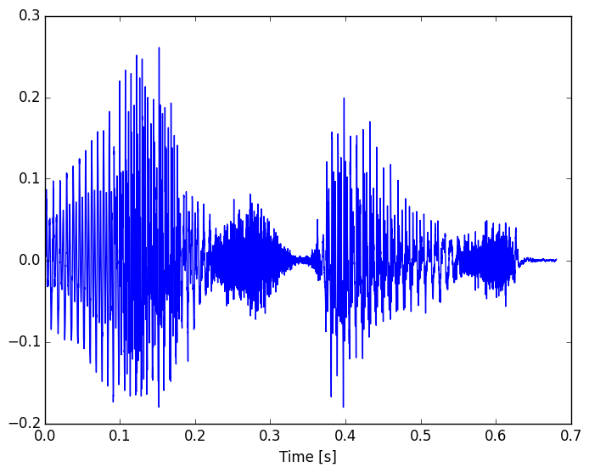
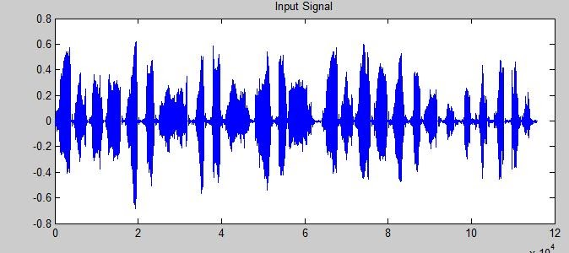

Coyotes
I know what a normal NYC soundscape is
Coyote noises
Machine learning
Hey, I don’t recognize those noises!

Slide 8
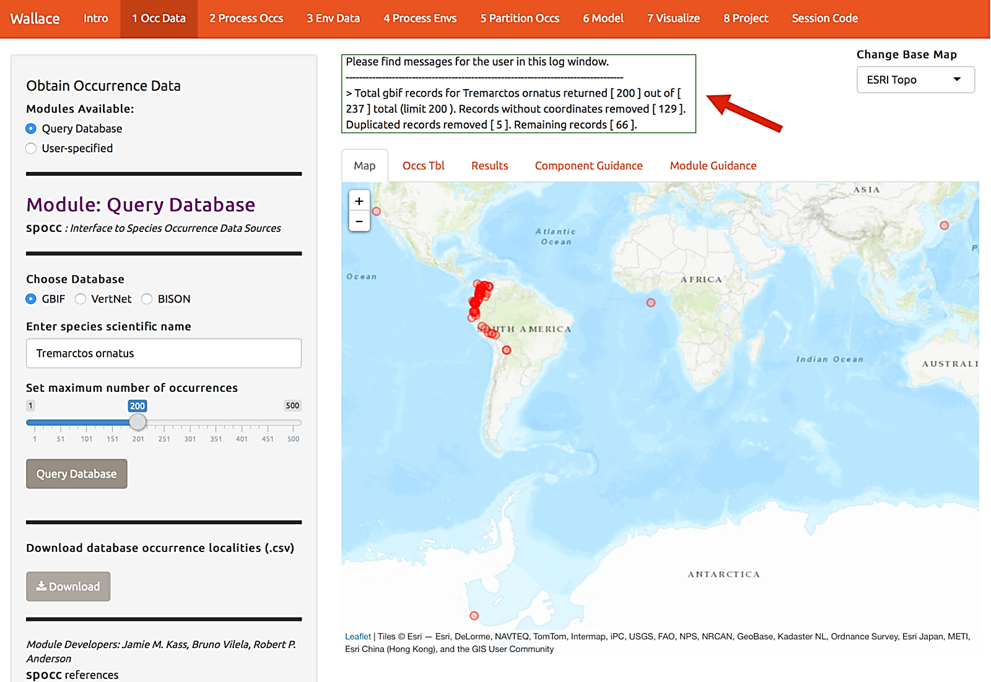
Wallace species distribution modeling

